Slide 1
Inventory management Sales Forcasting using ARIMA
precented by-Swagat Sharma

Slide 2
Topics to be covered
1- Domain
2- Problem Statement
3-Data collection
4-Data processing
5-Model Evaluation
7-Summary
8-Implementation

Slide 3
Domain
what is forcasting
Forecasting is the process of projecting past sales demand into the future. Implementing a forecasting system enables you to assess current market trends and sales quickly so that you can make informed decisions about the operations. We can use forecasts to make planning decisions about Customer orders
Need for forcasting
A forecast can play a major role in driving company success or failure. At the base level, an accurate forecast keeps prices low by optimizing a business operation - cash flow, production, staff, and financial management. ... It also helps increase knowledge of the market for businesses.
For a business to operate efficiently, it needs some idea of what the future will look like. A forecast provides this look as a foundation upon which to plan. Every functional group within a business benefits from a forecast.
For sales people, forecast numbers influence how the sales function is managed. Forecasts also help to understand customer engagement and therefore shape marketing efforts. Since forecasts estimate an expected sales volume over a specified period of time, salespeople can use them to set their activity goals, and subsequent adjustments can be made to reach sales goals. Marketers can use forecasts to gauge the effectiveness of their campaigns, decide which markets to enter and exit, and determine the life cycle of their products.

Slide 4
Questions to Ask Before Forecasting
Since forecasts attempt to look into the future, certain assumptions need to be made that form the basis of the forecast. The more accurate the assumptions are, the more accurate the forecast, but changing circumstances can dramatically affect a forecast’s accuracy. Businesses need to take the following into account:
Changes to the market. How much will the market at large grow? What other competition forces exist that might affect market share?
Customer behavior. Businesses need an idea of how many customers are gained and lost each year, whether there are certain periods of greater sales fluctuation (e.g., seasonality), and the average customer sales, along with their variance.
Resources. Businesses also need to be aware of how much they may be required to grow and the limitations, as well as how much to spend in advertising and what is driving or hurting sales.

Slide 5
Problem Statement
What is a problem statement
A problem statement is a concise description of an issue to be addressed or a condition to be improved upon. It identifies the gap between the current (problem) state and desired (goal) state of a process or product.
Focusing on the facts, the problem statement should be designed .With the help of our problem statement we will build our model.
Problem statement used in this model
In this model our problem statement is :- we have the data for a wine making Company and we need to
forcast the sales data for the upcoming year
TASK:-
We need to do the sales forcast using apporiate model to get the desiariable output

Slide 6
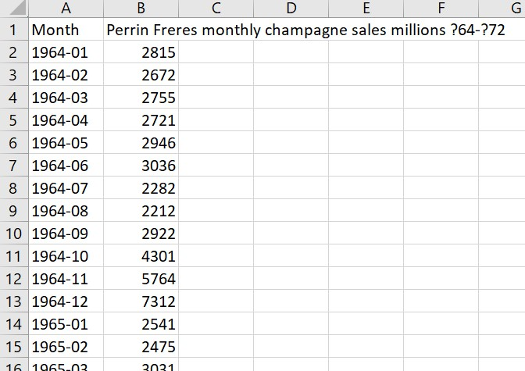
Data collection
For this model we collected a data of a wine company who has the data of almost
two years
https://www.kaggle.com/galibce003/perrin-freres-monthly-champagne-sales
As we can see there are two coloumns in this data 1.months 2.Perrin Freres monthly champagne sales million
we have the data for almost 2 years ,we need to use apporiate model to get the desirable ouyput from the model

Slide 7
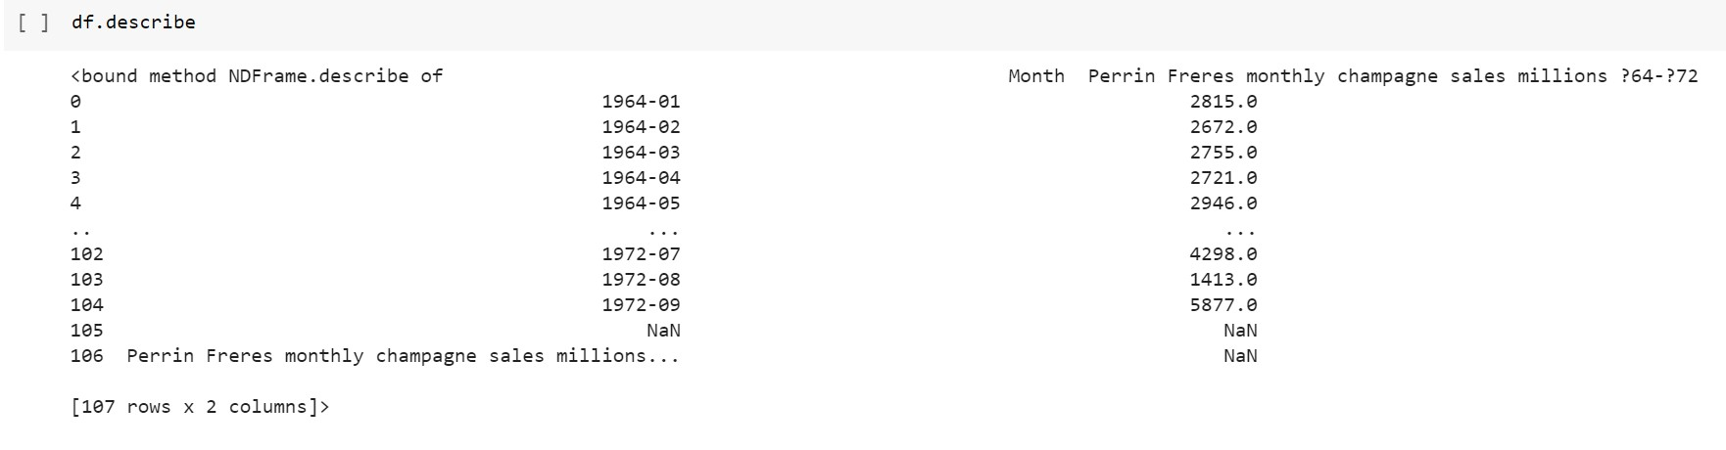
Data processing

Slide 8
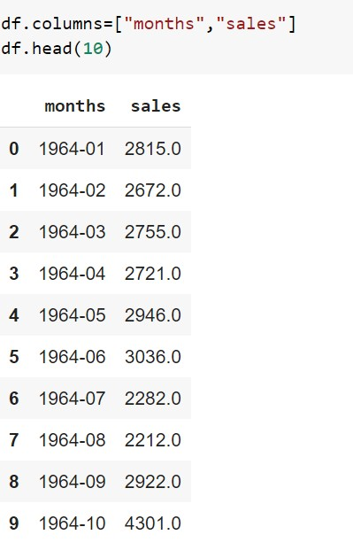
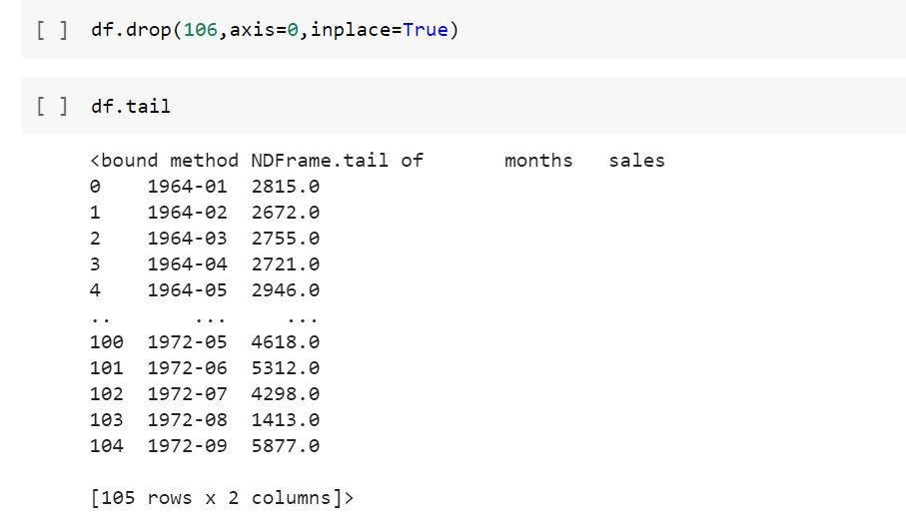
In the previous slide we describe the data and found out that there are some NAN values present.
we converted the monts colomn to date time to make the data more manageble
We need to drop those valuse to make the data processiable
It is not recomnded to drop the values but as the sample size of the data is big it is managable to drop the NAN valuse

Slide 9
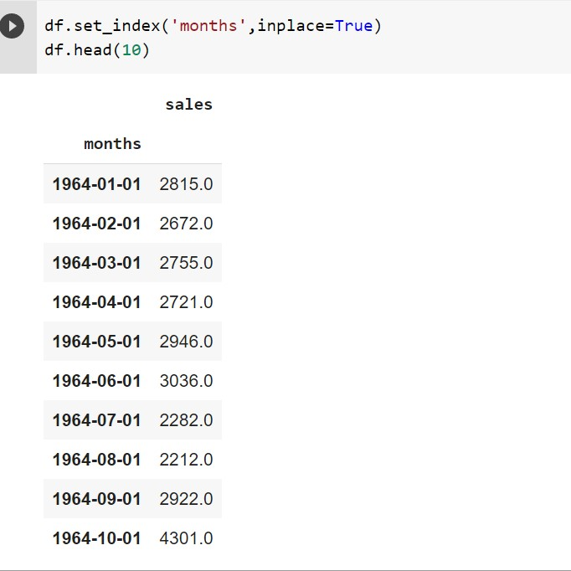
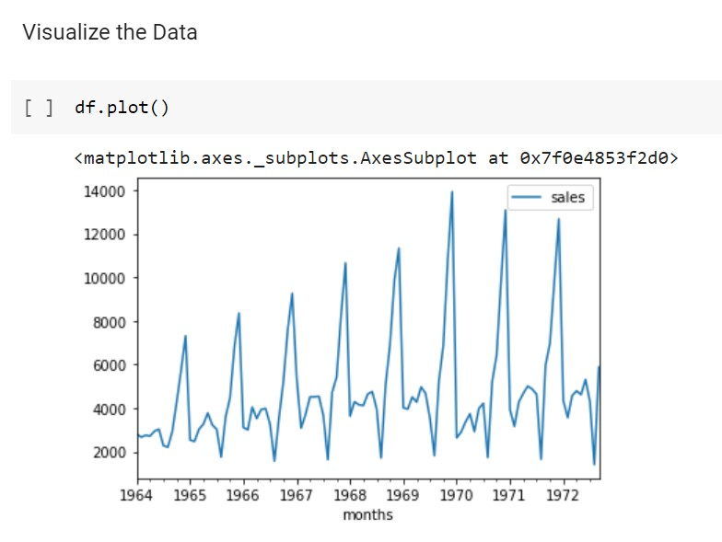
here what we do is make the months column as the index for the plotting of the graph to check wheather the data is seasonal or not

Slide 10
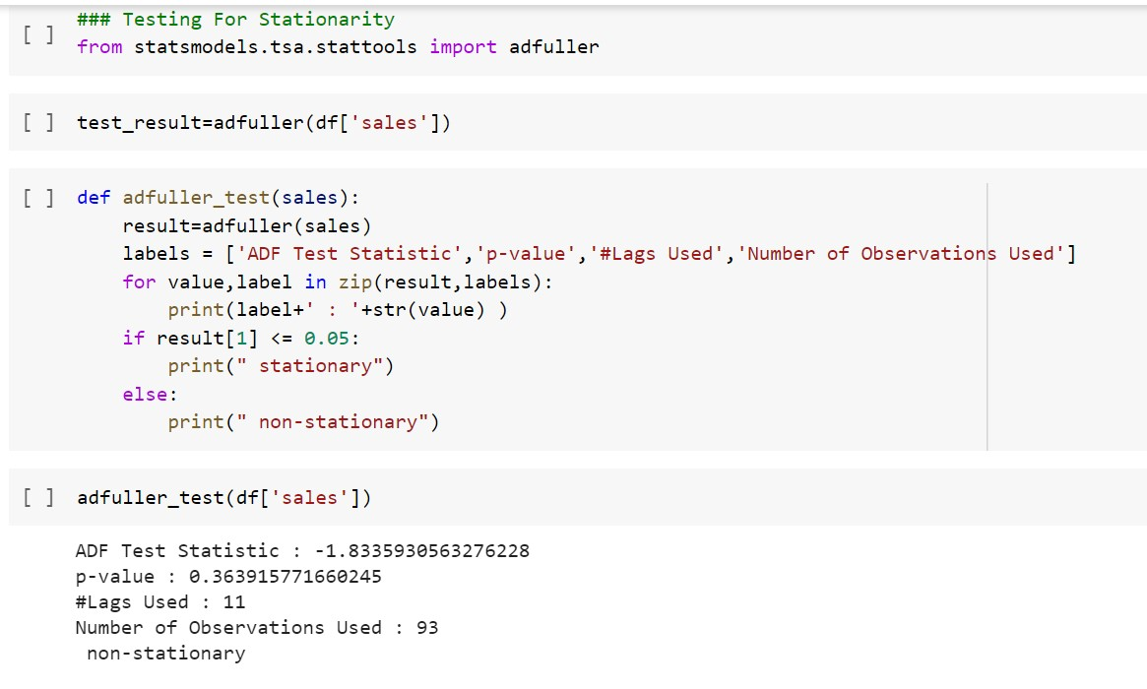
Now we need to check wheater our data is statianary or not.
for that we can use Dickey -Fuller test.before that we need to know what is statianarity in the data
What is SEASONALITY?
Predictable pattern that recurs or repeats over regular intervals. Seasonality is often observed within a year or less.
Components of a Time Series:
Trend
Seasonality
As our P value is greater than 0.05 so the data is
non_stationary

Slide 11
What is a TREND in time series?
Trend is a pattern in data that shows the movement of a series to relatively higher or lower values over a long period of time.
Trend usually happens for some time and then disappears, it does not repeat. For example, some new kaggle kernels, it goes trending for a while, and then disappears. There is fairly any chance that it would be trending again.
A trend could be :
UPTREND: Time Series Analysis shows a general pattern that is upward then it is Uptrend.
DOWNTREND: Time Series Analysis shows a pattern that is downward then it is Downtrend.
HORIZONTAL TREND: If no pattern observed then it is called a Horizontal or stationary trend.

Slide 12
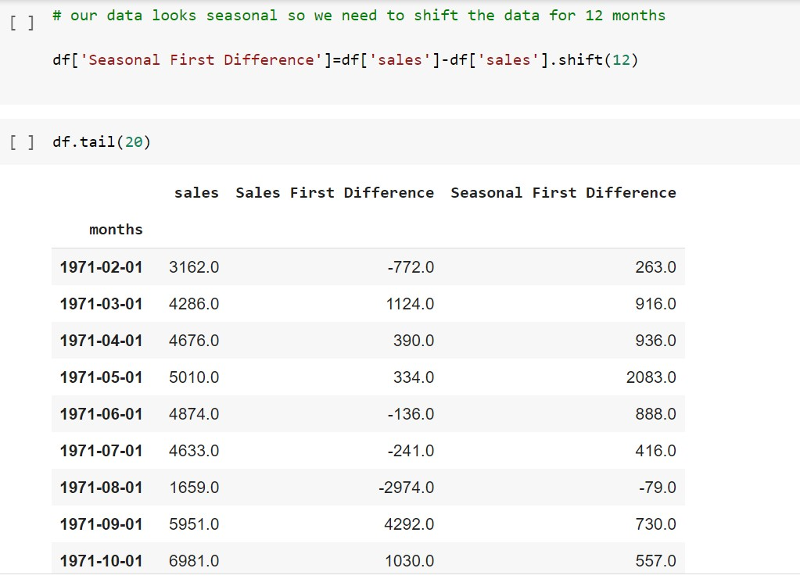
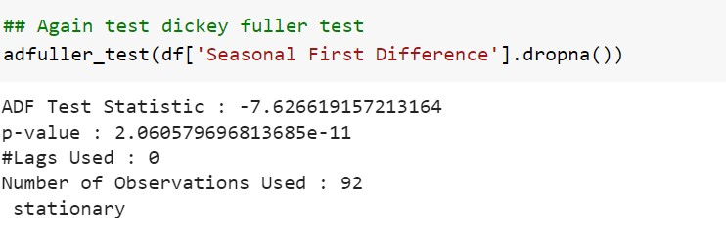
as our data looks seasonal so we we need to shift the data for 1 month and 12 months
then we need to check for the stationarity again
after doing the dickey_fuller test we can conclude taht the data is statianary now we can proceed to doing the forcasting

Slide 13
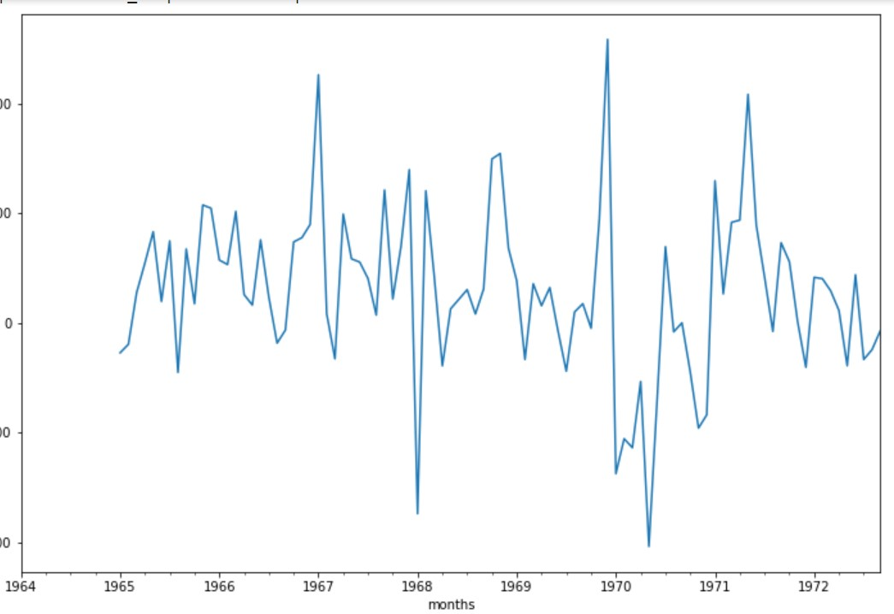
after plotting the Seasonal First Difference

Slide 14
Model Evaluation
Identification of an AR model is often best done with the PACF.
For an AR model, the theoretical PACF “shuts off” past the order of the model. The phrase “shuts off” means that in theory the partial autocorrelations are equal to 0 beyond that point. Put another way, the number of non-zero partial autocorrelations gives the order of the AR model. By the “order of the model” we mean the most extreme lag of x that is used as a predictor.
Identification of an MA model is often best done with the ACF rather than the PACF.
For an MA model, the theoretical PACF does not shut off, but instead tapers toward 0 in some manner. A clearer pattern for an MA model is in the ACF. The ACF will have non-zero autocorrelations only at lags involved in the model.
p,d,q p AR model lags d differencing q MA lags

Slide 15
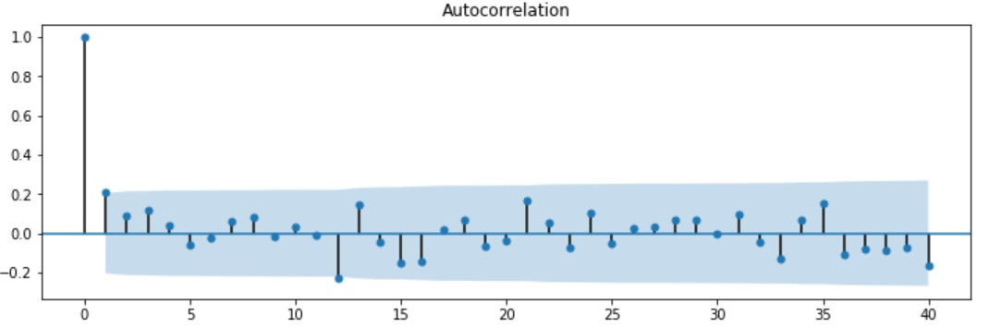
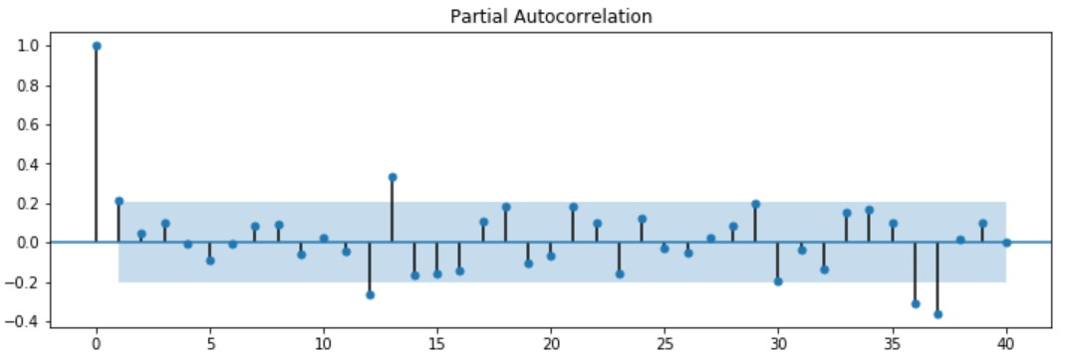

Slide 16
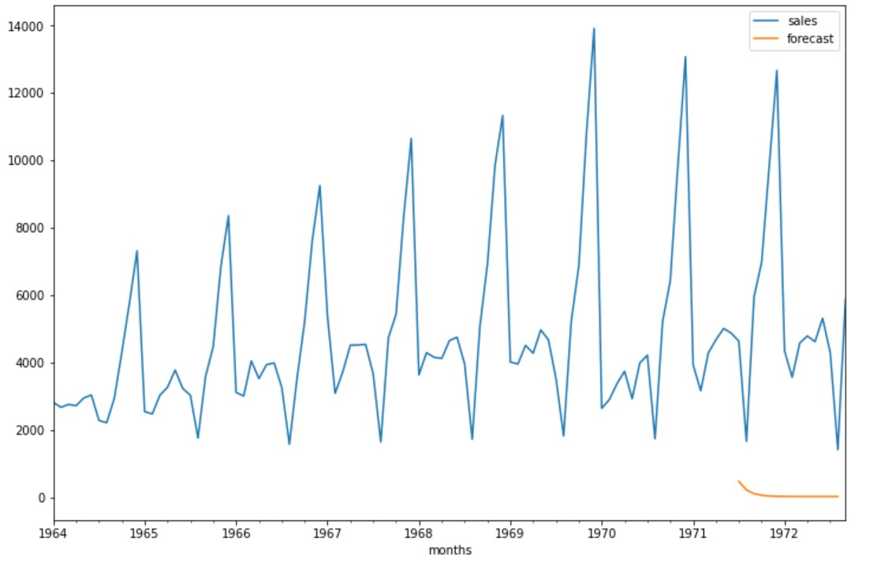
#For non-seasonal data
p=1, d=1, q=0 or 1
d = 1 beacause only one thime we shifted the seasonal diffrence
from statsmodels.tsa.arima_model import ARIMA
As it is seasonal our mmodel doesnot perform well
ARIMA is an acronym that stands for AutoRegressive Integrated Moving Average. It is a class of model that captures a suite of different standard temporal structures in time series data.

Slide 17
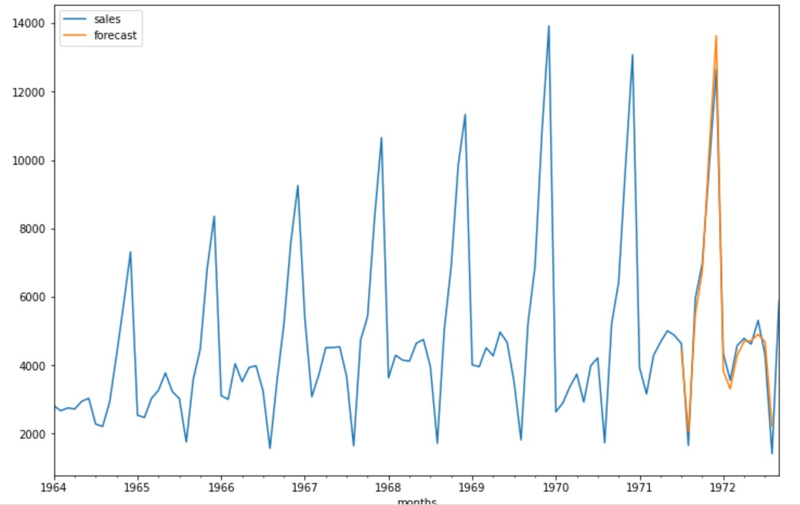
Model selection
now we need to use SARIMAX
As our data is a seasonal one we need to use
SARIMAX
Seasonal Auto-Regressive Integrated Moving Average with eXogenous factors, or SARIMAX, is an extension of the ARIMA class of models. Intuitively, ARIMA models compose 2 parts: the autoregressive term (AR) and the moving-average term (MA). The former views the value at one time just as a weighted sum of past values.
as we cam see out model is performing well and the forcasted values are similar to the actual values

Slide 18
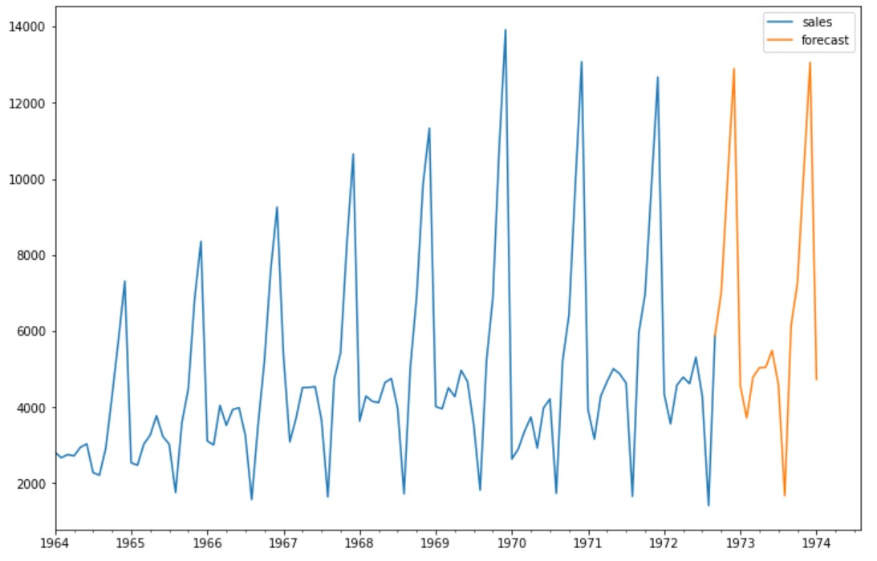
Now what we will do is we will make a data set for the future preditiction
and make the prediction for upcoming 2 years
As we can see the forcasted data is coming similar to the actual data

Slide 19
Implementation
eCommerce company
Retail store
supermarket

Slide 20
Thank you

